Slide 1
LANGUAGE IDENTIFIER
MINI PROJECT
Team members
AMRUTHA RAMANAN (7208181006)
ASWIN S (7208181009)
Tamil Selvan V P(7208181058)
VIGNESH Kumar K(7208181061)
PROJECT GUIDE
Dr.A.JAMEER BASHA,
PROFESSOR AND HEAD
OF COMPUTER SCIENCE AND ENGINEERING

Slide 2
Introduction
Language identifier is the process of detecting Indian language spoken by the user.
It accurately identify the language from the given speech sample.
We introduce the software that is able to detect all the Indian languages in real-world data.
Implementation of an application for knowing the probability of the language.

Slide 3
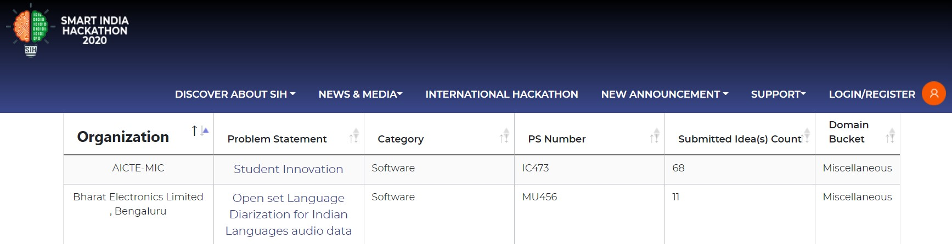
Problem Statement
Software based module for segmentation and identification of Indian languages from the given input audio file. Objective of the software module is:
a) Input should be narrow band speech data.
b) Output should be labelled for languages with respect to time.
c) Language labelling for a minimum 15 seconds audio segment.
d) Capable to identify all 24 official Indian languages from given audio file.
e) Non-Indian languages need to be labelled as unknown.

Slide 4
Objectives
Our primary goal is to design a software based module for segmentation and identification of Indian languages from the given input audio file.
Input file will be narrow band speech data.
It will be capable of detecting major languages of India from given audio file.
Non- Indian languages will be labelled as ‘unknown’.
Capable to give high accuracy .

Slide 5
Methodology
We use Python with Machine learning to implement this project.
It gathers the input file as audio of the user, which identifies the language spoken by the user.
To achieve this we are going to use 2 main methods
Tensor-Flow with Keras package
Pyaudio package
TensorFlow
-end to end open source library for machine learning.
-focuses on training and inference of deep neural networks.
-symbolic math library based on dataflow and programming.
Keras
-open-source library for artificial neural networks in Python.
-acts as an interface for the TensorFlow library.
Pyaudio
- To get started with playback and recording audio on Windows, Linux, and MacOS in a Python environment you should consider using the Pyaudio library.
- It access the microphone to process the input audio file.

Slide 6
Work Plan
Optimized Audio Classification and Segmentation Algorithm
Training audio to the system
Decode the audio
Get the input audio
Compares with trained audio
Detect the language

Slide 7
Optimized Audio Classification and Segmentation Algorithm

Slide 8
Training Audio Dataset - I
Database:
Training :
The recorded speech is uttered by different users thus providing probability of the language.
To train the audio set each sentence is uttered by different users at different frequencies.
Testing :
For Testing the data the speech uttered by different users like 20 times for testing the system.

Slide 9
Training Audio Dataset - II
Mel Frequency Cepstral Coefficients (MFCC)
Identify useful content and discard unwanted information like noise, background etc...
Noise Cancellation:
Produced due to difference of amplitudes of speech waveform.
Spectrogram
It shows frequency changes overtime and can be represented as a 2D Image by Fourier Transform.
The data waveform will be compared with spectrogram and the actual audio of the dataset.

Slide 10
Module - Teachable Machine
Teachable Machine is a tool created by Google and Use All Five, with the help of TensorFlowJS, to make machine learning and artificial intelligence available to everyone. Usually machine learning algorithms are developed using different frameworks specialized for machine learning, like Pytorch or TensorFlow.
This repository contains two components of Teachable Machine:
1. A libraries section that contains all of the machine learning code used like to train and run the models
2. A snippets section that contain code and instructions on how to use the exported models from Teachable Machine in languages like JavaScript, Java and Python.
By using this tool, we can show the probality of speech spoken by the user.

Slide 11
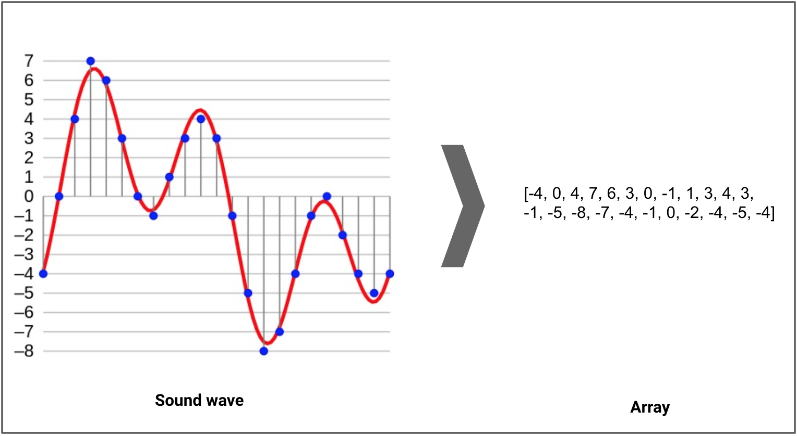
Training Module
The high quality speech recordings is trained using high volume in speech recognition.
By using Machine learning we can classify , describe and generate audio where the input data are audio sample.
The input audio goes through the microphone which is simplified in a bandpass filter.

Slide 12
APPLICATIONS
There are 22 major languages in India, out of which only 8 languages are supported in Google Assistant.
Other Major Languages like Nepali, Manipuri, Urudhu etc… are not in Google Assistant.
The basic goal of the language identifier is to accurately identify the language from the given speech sample.
It is also used in
For automatic speech recognition
Machine Translation
Information Retrieval
Increases Translating efficiency
Multilingual translation systems
Applied in call centres

Slide 13
System Requirements
HARDWARE REQUIRMENTS
PROCESSOR : Intel i7 8Gen / Ryzen 7
OPERATING SYSTEM : Windows/Mac/Linux
RAM : 32 GB DDR4 3200Mhz
GPU : 16GB GDDR6
MEMORY : 256GB SSD/1TB Hard Disk
SMART PHONE REQUIREMENTS
PROCESSOR : Snapdragon
RAM : 4 GB RAM
ANDROID VERSION : Android 6.0
DISK SPACE : 90MB
SOFTWARE REQUIREMENTS
OPERATING SYSTEM : Android
CODING LANGUAGE : Kotlin & Python
IDE : Android Studio
FRONT END : Android SDK
BACK END : Kotlin programming, python
Network speed : 50 Mega Bytes / Second

Slide 14
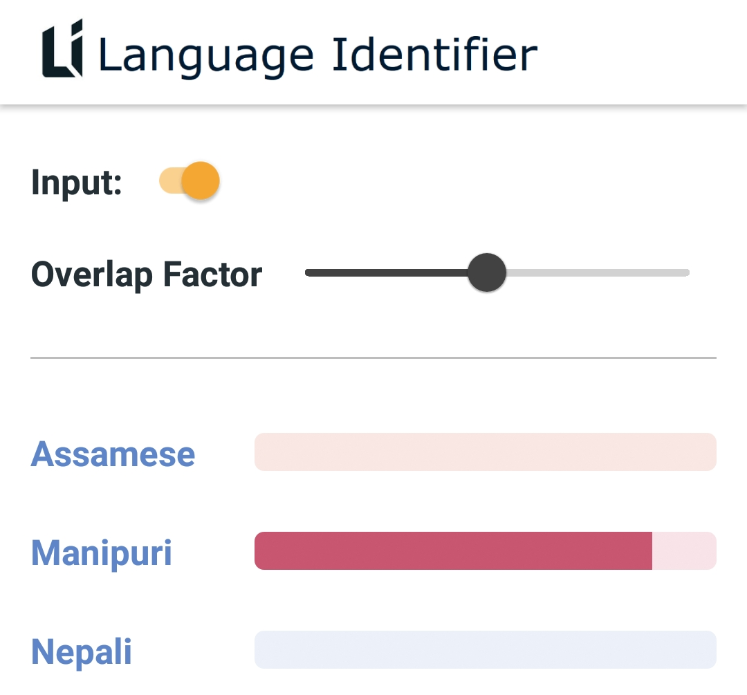
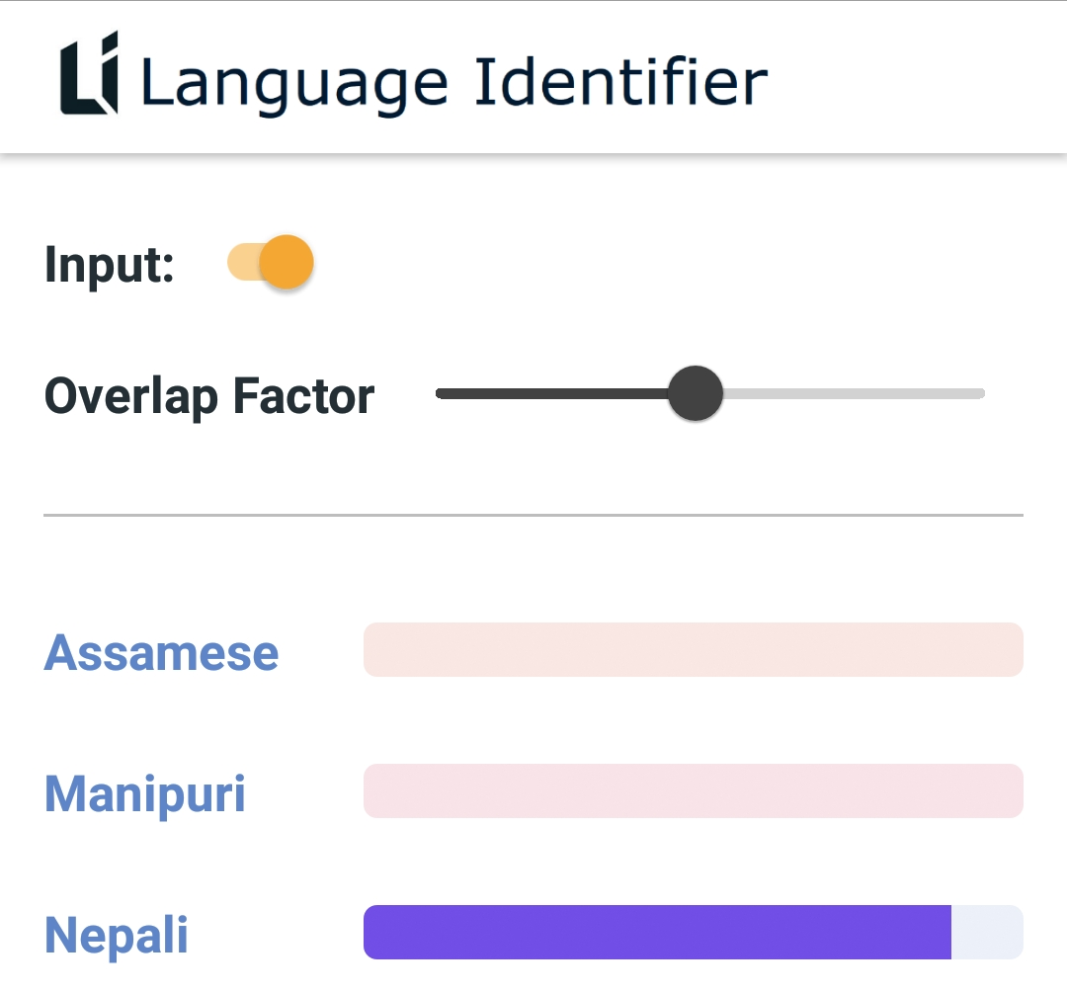
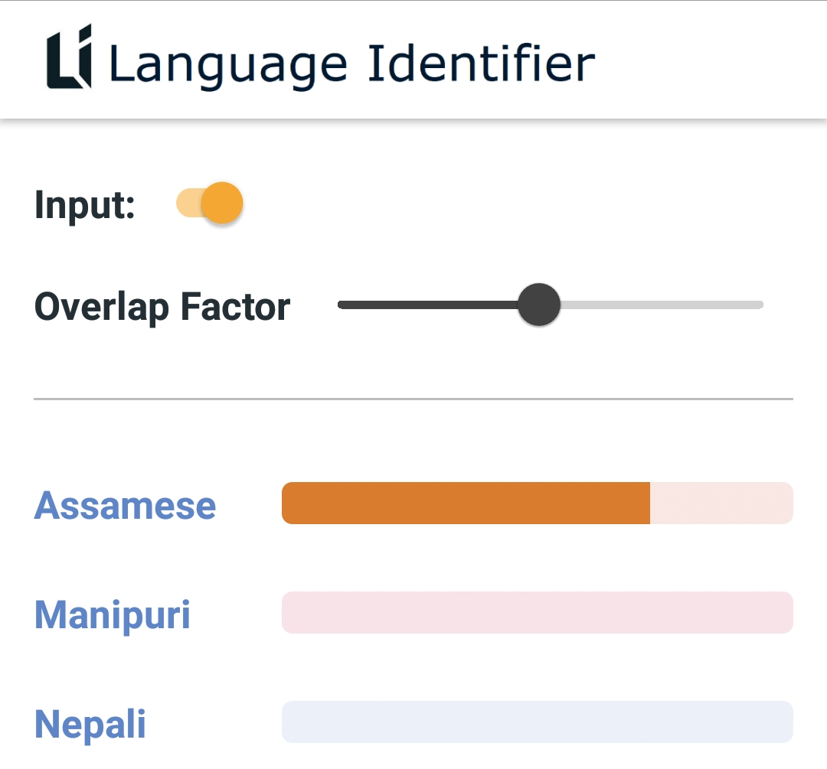
Output
Speaking in “Manipuri”
Speaking in “Nepali”
Speaking in “Assamese”

Slide 15
Conclusion
This project is created for the use of company’s customer care support and it is also used for automatic speech recognition.
Using this application, we can detect the Indian languages in Multilingual translation systems in smart phone
We introduce the software that is able to detect all the Indian languages in real-world data.
This application shows the probability of the language spoken by the user at the run time.

Slide 16
THANK YOU

